Slide 1


Sprocket Central Pvt Ltd
Data analytics approach – Data Quality, Data Insights & Presentation
Ashwajit Barua – 2020UGMM046, Data Analyst Consulting Intern. I completed my Data Analytics Intern from KPMG, Completed a simulation focused on advising a client on customer targeting with the Data, Analytics & Modelling team. Assessed data quality and completeness in preparation for analysis.
Analyzed data to target high-value customers based on demographics and attributes. Developed dashboards to communicate findings with visuals. This is the presentation that I was required to prepare for Sprocket Central Pvt Ltd on the basis of the given data provide by them, I was a part of TheAnalyticsTeam which was working on this data. It consists of Data Interpretation, Model Deployment, Interpretation.

Slide 2
Agenda
Introduction
Data Exploration
Model Development
Interpretation

Slide 3
Introduction
Customers Analysis
Age distributions
Number of bike purchases in 3 years / percentages purchases
Job industry category
Wealth segments
Number of cars own on each states

Slide 4
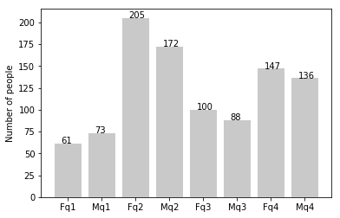
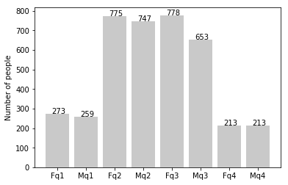
Data Exploration
new
Customers’ Age Distribution
As we can see, mostly our new customers are between 25 to 48 years old.
Number of customers from 48 to 59 years old has big drops on percentages.
There is a slightly increase in number of customers over 59 years old in term of percentages
It looks like the percentages of under 25 years old not really change.
old

Slide 5
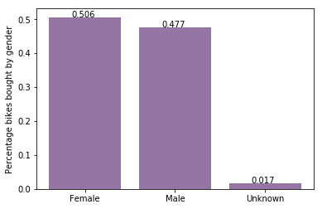
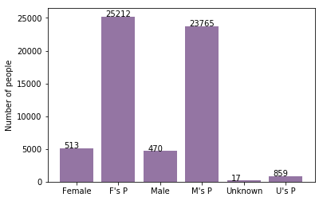
Model Development
Bike Purchases in Last 3 Years
As we can see, our new customers mostly Female with 50.6% purchases with total of 25,212 bikes
Male contributed to 47.7% purchases with 23,765 bikes
So we should focus on advertises on Female customers than Male customers

Slide 6
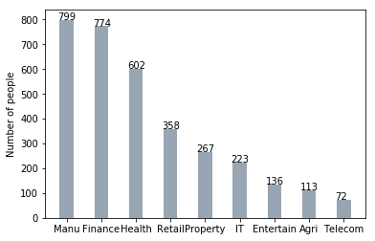
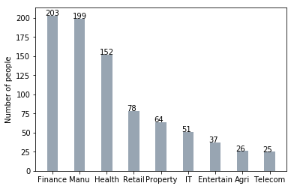
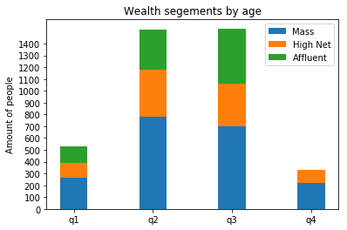
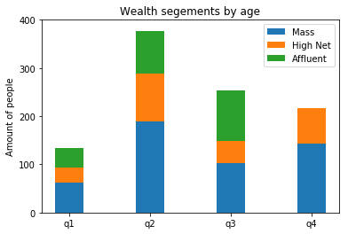
Interpretation
Job Industry Category
Mostly our new customers are on Finance industry and our Manufacturing customers are still on top 2.
The rest industries is still same
Wealth Segments
In all ages, the number of Mass Customers is the highest so we should focus on this social class.
After that, we should focus on High Net Customer.
Then Affluent Customers but mostly second and third quadrant

Slide 7
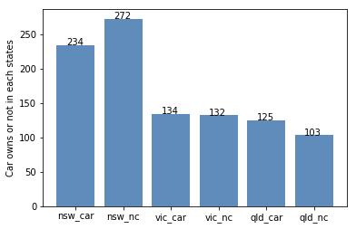
Interpretation
Numbers of Cars Owned
NSW should be considered the most since numbers of customers don’t own cars is significantly larger than that own.
VIC and QLD has more customers that own car that who don’t but we can try to have something so that those owns car will buy bikes.

Slide 8
Thank You

